Slide 1
VINITHA NEELI
EMPLOYEE ID: 153044
JEE FULL STACK, MIPL

Slide 2
Team Members:
Vinitha Neeli
Khishore Kumar
Pravalika Nayana
Archana Emmadi

Slide 3
CapStore Shopping Application

Slide 4
Project Requirements

Slide 5
Softwares:
Java 10
STS Version: 3.9.4.RELEASE
MySQL 5.5 Command Line Client
HTML 5
CSS 3
BootStrap
JavaScript
JSP
Spring Boot (2.0.4)
Spring Rest
Notes:
Fixar a posicao do titulo – sempre do lado esquerdo.
Sempre que tiver muito texto o coluna deve sempre ser “ narrowed” , se nao fica dificil de ler. Colocar paragrafos no texto.
Linha vertical deve ser mais fina e as pontas NUNCA devem ser arredondadas.

Slide 6
MODULE
CRASH RECOVERY

Slide 7
Crash Recovery
The customer is on the product page and wants to add the product into cart.
The customer either clicks on BUY NOW button or ADD TO CART for the selected product.
If the customer wishes to Buy instantly, he/she is navigated to the shipping details page allowing him/her to give the shipping address details.
Prior to this, an Cart Id is auto-generated for the purchased product, which is used for accessing the product details in future.
If the customer clicks on Add To Cart ,the he/she is navigated to cart page and Cart Id is auto-generated .

Slide 8
In the Cart Page customer can view all the added products.
In the Cart Page customer can remove the product by clicking on REMOVE button.
Here the customer sets the quantity and clicks on Check-Out button and is navigated to the shipping details page.

Slide 9
Customer
customerId
customerName
phoneNumber
emailId
dateOfBirth
password
addressId
lastLogin
isActive
shippingId
bankId
cartId
feedBackId
returnOrdersId
wishListId
invoiceId
Tables Used
Inventory
productId
category
dateOfInclusion
description
expiryDate
noOfViews
Price
productName
quantity
brandId
couponId
discountId
invoiceProductId
merchantId
ManagingCart
cartId
quantity
status
customerId
productId
orderId

Slide 10
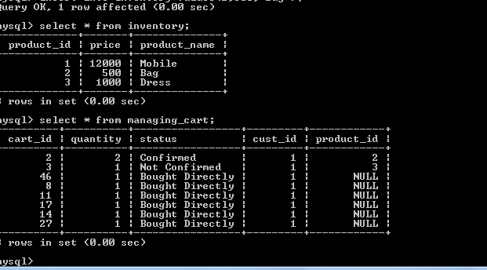

Slide 11
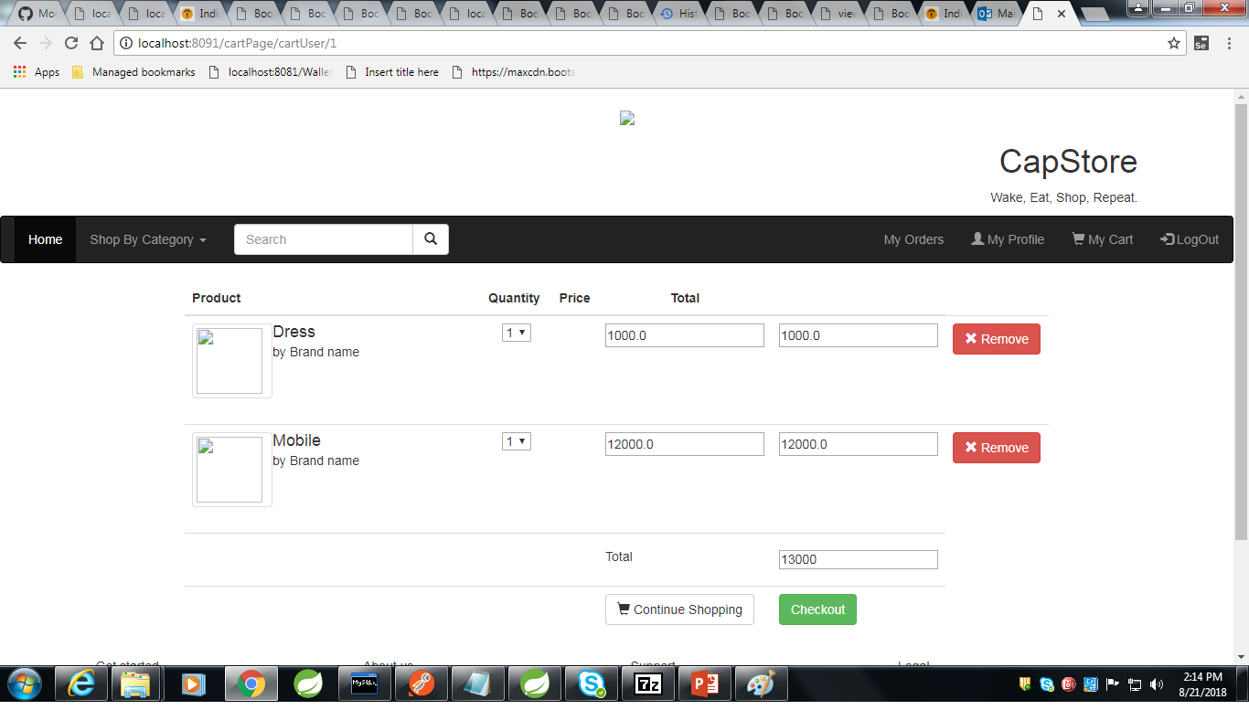
Cart Page

Slide 12
Thank You
Notes:
O Box atras do texto desnecessario. Deixar o layout mais simples.

